Slide 1

Power BI Desktop
Pr. Abdessamad BENLAHBIB

Slide 2
What is Power BI?
Power BI is a collection of software services, apps, and connectors that work together to turn your unrelated sources of data into coherent, visually immersive, and interactive insights. Your data might be an Excel spreadsheet, or a collection of cloud-based and on-premises hybrid data warehouses. Power BI lets you easily connect to your data sources, visualize and discover what's important, and share that with anyone or everyone you want.

Slide 3
The parts of Power BI
Power BI consists of several elements that all work together, starting with these three basics:
A Windows desktop application called Power BI Desktop.
An online software as a service (SaaS) service called the Power BI service.
Power BI Mobile apps for Windows, iOS, and Android devices.

Slide 4
The parts of Power BI
Power BI Desktop is an application that you download and install for free on your local computer. Desktop is a complete data analysis and report creation tool that is used to connect to, transform, visualize, and analyze your data. It includes the Query Editor, in which you can connect to many different sources of data, and combine them (often called modeling) into a data model. Then you design a report based on that data model. Reports can be shared with others directly or by publishing to the Power BI service. Sharing reports requires a Power BI Pro license.

Slide 5
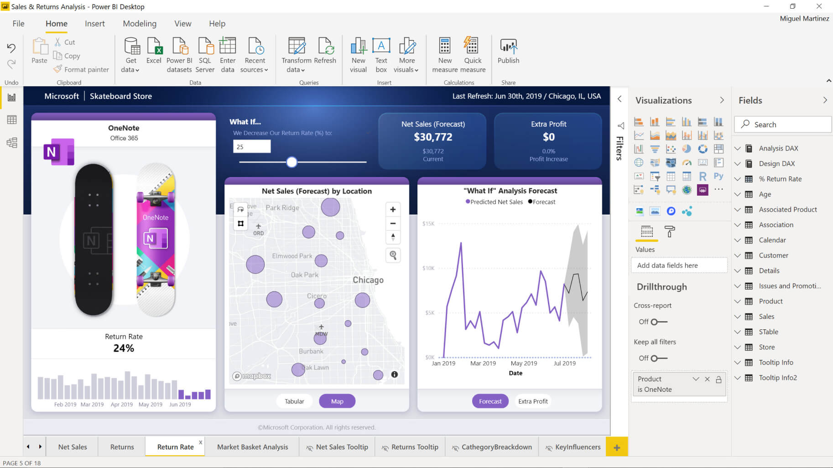
The parts of Power BI

Slide 6
The parts of Power BI
Power BI service is a cloud-based service, or software as a service (SaaS). It supports report editing and collaboration for teams and organizations. You can connect to data sources in the Power BI service, too, but modeling is limited. The Power BI service is used to do things such as creating dashboards, creating and sharing apps, analyzing and exploring your data to uncover business insights, and much more. What is the Power BI service details many of the capabilities of the Power BI service. Your license determines what you can do in the Power BI service.

Slide 7
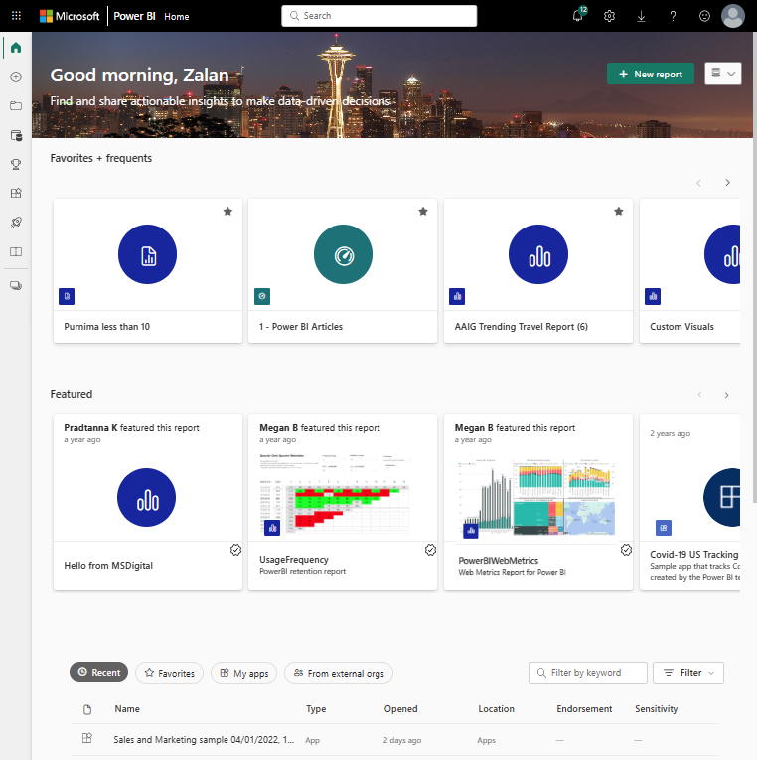
The parts of Power BI

Slide 8
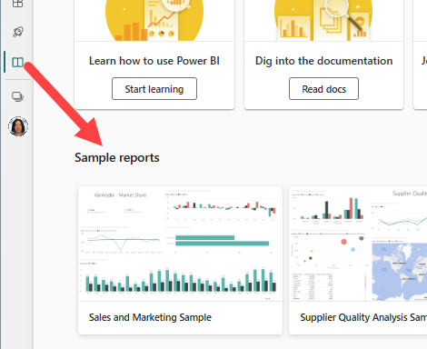
The parts of Power BI

Slide 9
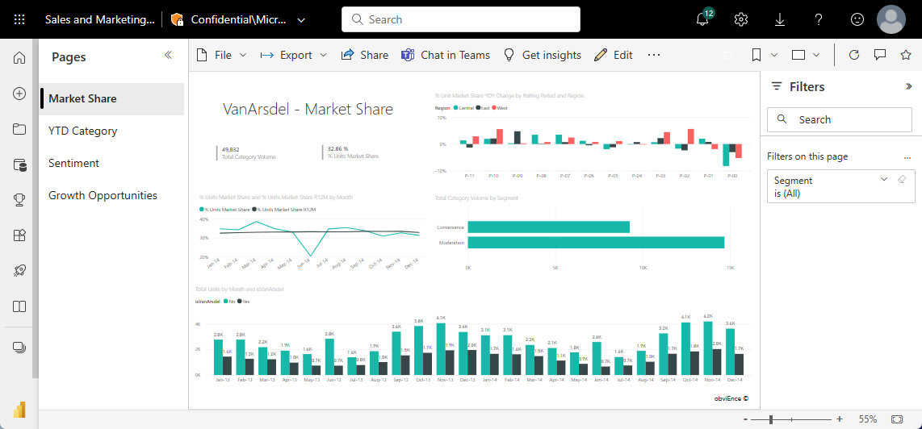
The parts of Power BI

Slide 10
The parts of Power BI
Power BI Mobile apps Power BI mobile apps are applications for your mobile and tablet devices that enable you to quickly view your Power BI reports and dashboards. They allow you to connect to your data, make insights, collaborate on the go, and get notified whenever your data changes.
Power BI mobile apps allow you to consume your data, however, you cannot create or edit reports. The apps work very similarly to the Power BI service. You can quickly navigate from different workspaces, reports, and dashboards by using tabs. You can interact with your Power BI reports by clicking on different visuals or using slicers to filter the data.

Slide 11
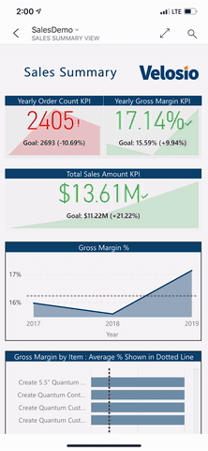
The parts of Power BI

Slide 12
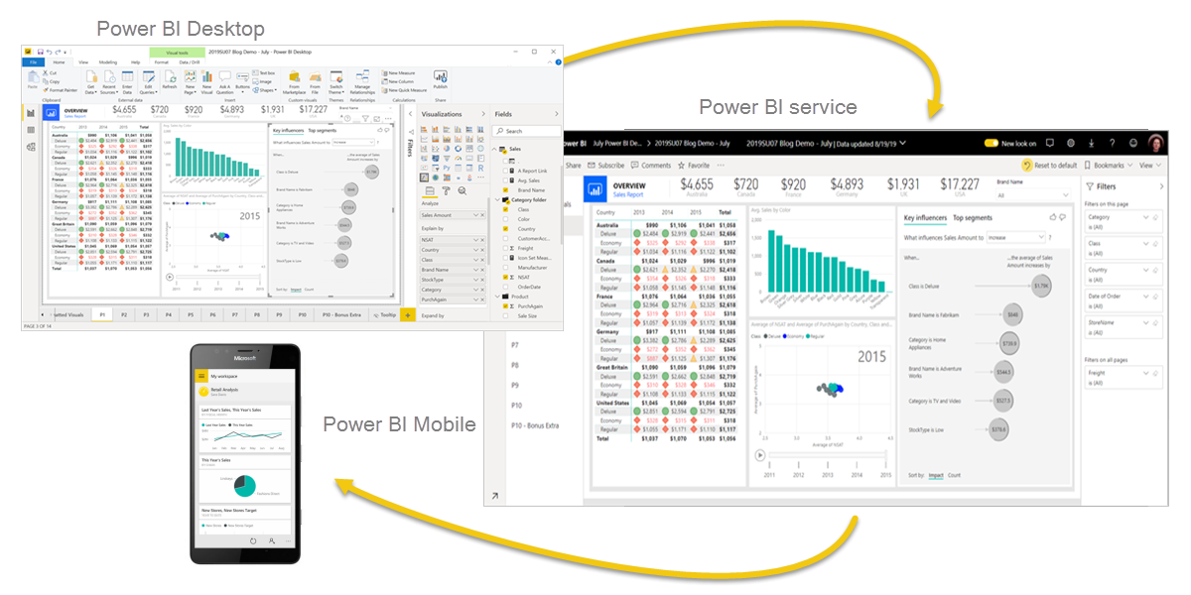
The parts of Power BI

Slide 13
The parts of Power BI
These three elements, Power BI Desktop, the service, and the mobile apps are designed to let you create, share, and consume business insights in the way that serves you and your role most effectively.

Slide 14
The flow of work in Power BI
One common workflow in Power BI begins by connecting to data sources in Power BI Desktop and building a report. You then publish that report from Power BI Desktop to the Power BI service, and share it so business users in the Power BI service and on mobile devices can view and interact with the report.
This workflow is common, and shows how the three main Power BI elements complement one another.

Slide 15
What is Power BI Desktop?
Power BI Desktop is a free application you install on your local computer that lets you connect to, transform, and visualize your data. With Power BI Desktop, you can connect to multiple different sources of data, and combine them (often called modeling) into a data model. This data model lets you build visuals, and collections of visuals you can share as reports, with other people inside your organization. Most users who work on business intelligence projects use Power BI Desktop to create reports, and then use the Power BI service to share their reports with others.

Slide 16
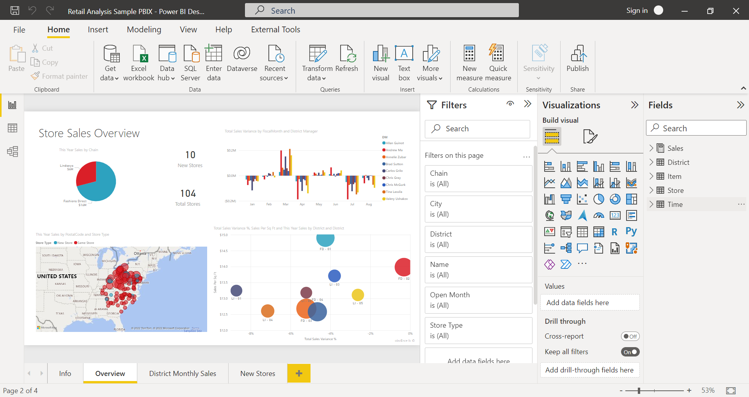
What is Power BI Desktop?

Slide 17
What is Power BI Desktop?
The most common uses for Power BI Desktop are as follows:
Connect to data.
Transform and clean data to create a data model.
Create visuals, such as charts or graphs that provide visual representations of the data.
Create reports that are collections of visuals on one or more report pages.
Share reports with others by using the Power BI service.

Slide 18
What is Power BI Desktop?
People who are responsible for such tasks are often considered data analysts (sometimes referred to as analysts) or business intelligence professionals (often referred to as report creators).

Slide 19
What is Power BI Desktop?
There are three views available in Power BI Desktop, which you select on the left side of the canvas. The views, shown in the order they appear, are as follows:
Report: You create reports and visuals, where most of your creation time is spent.
Data: You see the tables, measures, and other data used in the data model associated with your report, and transform the data for best use in the report's model.
Model: You see and manage the relationships among tables in your data model.

Slide 20
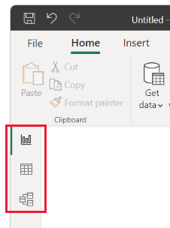
What is Power BI Desktop?
The following image shows the three views, as displayed along the left side of the canvas:

Slide 21
Connect to data
To get started with Power BI Desktop, the first step is to connect to data. There are many different data sources you can connect to from Power BI Desktop.
To connect to data:
From the Home ribbon, select Get Data > More.
The Get Data window appears, showing the many categories to which Power BI Desktop can connect.

Slide 22
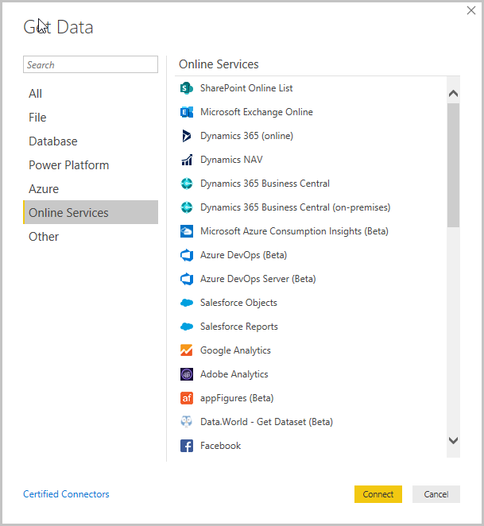
Connect to data

Slide 23
Connect to data
To connect to data:
From the Home ribbon, select Get Data > More.
The Get Data window appears, showing the many categories to which Power BI Desktop can connect.
When you select a data type, you're prompted for information, such as the URL and credentials, necessary for Power BI Desktop to connect to the data source on your behalf.

Slide 24
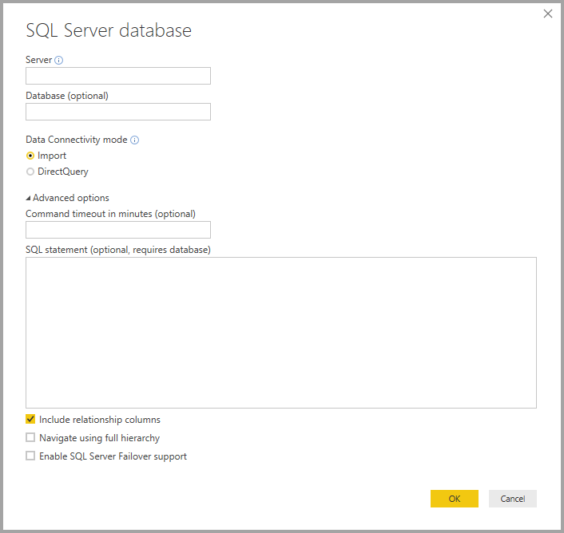
Connect to data

Slide 25
Connect to data
To connect to data:
From the Home ribbon, select Get Data > More.
The Get Data window appears, showing the many categories to which Power BI Desktop can connect.
When you select a data type, you're prompted for information, such as the URL and credentials, necessary for Power BI Desktop to connect to the data source on your behalf.
After you connect to one or more data sources, you may want to transform the data so it's useful for you.

Slide 26
Transform and clean data, create a model
In Power BI Desktop, you can clean and transform data using the built-in Power Query Editor. With Power Query Editor, you make changes to your data, such as changing a data type, removing columns, or combining data from multiple sources. It's like sculpting: you start with a large block of clay (or data), then shave off pieces or add others as needed, until the shape of the data is how you want it.

Slide 27
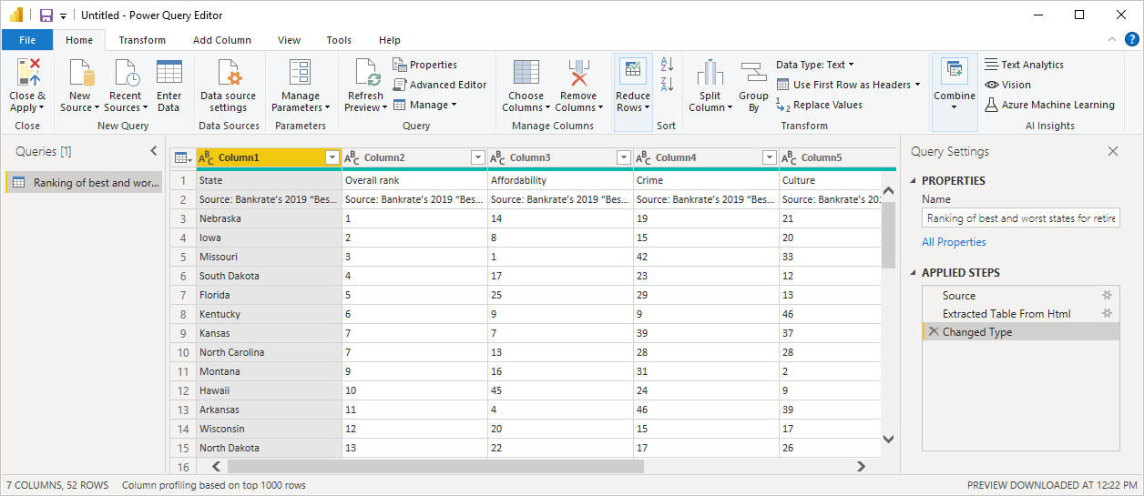
Transform and clean data, create a model
To start Power Query Editor:
On the Home ribbon, in the Queries section, select Transform data.
The Power Query Editor window appears.

Slide 28
Transform and clean data, create a model
Each step you take in transforming data (such as renaming a table, transforming a data type, or deleting a column) is recorded by Power Query Editor. Every time this query connects to the data source, those steps are carried out so that the data is always shaped the way you specify.
The following image shows the Power Query Editor window for a query that was shaped, and turned into a model.

Slide 29
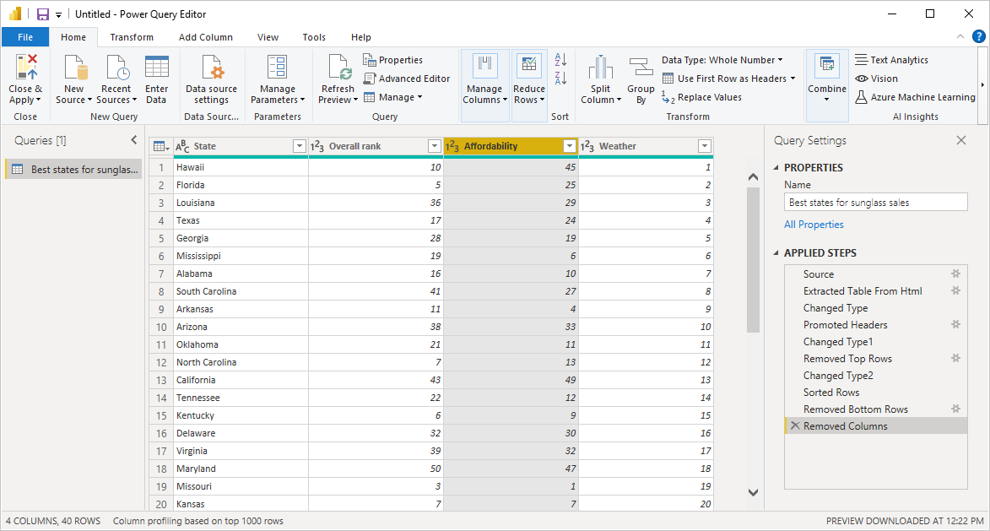
Transform and clean data, create a model
Once your data is how you want it, you can create visuals.

Slide 30
Create visuals
After you have a data model, you can drag fields onto the report canvas to create visuals. A visual is a graphic representation of the data in your model. There are many different types of visuals to choose from in Power BI Desktop. The following visual shows a simple column chart.

Slide 31
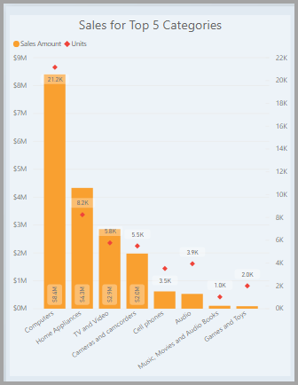
Create visuals

Slide 32
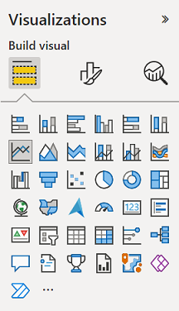
Create visuals
To create or change a visual:
From the Visualizations pane, select the Build visual icon.

Slide 33
Create visuals
If you already have a visual selected on the report canvas, the selected visual changes to the type you selected.
If no visual is selected on the canvas, a new visual is created based on your selection.

Slide 34
Create reports
More often, you'll want to create a collection of visuals that show various aspects of the data you've used to create your model in Power BI Desktop. A collection of visuals, in one Power BI Desktop file, is called a report. A report can have one or more pages, just like an Excel file can have one or more worksheets.
With Power BI Desktop you can create complex and visually rich reports, using data from multiple sources, all in one report that you can share with others in your organization.

Slide 35
Create reports
In the following image, you see the first page of a Power BI Desktop report, named Overview, as seen on the tab near the bottom of the image.

Slide 36
Share reports
After a report is ready to share with others, you can publish the report to the Power BI service, and make it available to anyone in your organization who has a Power BI license.
You need a Power BI Pro license to share your content. The people you share it with do too, or the content needs to be in a workspace in a Premium capacity

Slide 37
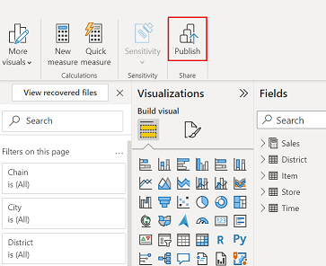
Share reports
To publish a Power BI Desktop report:
Select Publish from the Home ribbon. Power BI Desktop connects you to the Power BI service with your Power BI account.

Slide 38
Share reports
To publish a Power BI Desktop report:
Select Publish from the Home ribbon. Power BI Desktop connects you to the Power BI service with your Power BI account.
You're prompted to select where in the Power BI service you'd like to share the report. For example, your workspace, a team workspace, or some other location in the Power BI service.
You must have a Power BI license to share reports to the Power BI service.

